Slide 1
Team 16
TravelVille

Slide 2
SYNOPSIS
Planning a vacation or a trip has never been easy, you usually have to do a lot of research in order to know about the place you want to visit and even then some things go unnoticed. While you can always tell people about the availability of the hotels, there is actually no one who tells you what to do when you reach there.
We intend to create a web page that makes this much easier, it will overcome all the above-mentioned problems. We intend to cover every tiniest details possible so that the only person who has to do research is us, and not the user
To achieve this, will use the best and state of the art APIs to find the best destinations and the best hotel booking offers. Our website's UI will be so easy that even grandpas and grandmas will be able to use it with ease.

Slide 3
TEAM MEMBERS INFO & ROLES
Team Members | Roll No. | Email
Pulkit Gupta | 1710991610 | Pulkit17160.cse@chitkara.edu.in
Rachit Kapoor | 1710991614 | Rachit171614.cse@chitkara.edu.in
Harshit Chaudhary | 1710991303 | Harshit171303.cse@chitkara.edu.in
Team Member Name | Team Member Role | Examples
Pulkit | Back-End & User Login | Server.js, Mongo DB
Rachit | API Integration | Locations.js,
Harshit | Complete Front-End | Travel & Result page etc.

Slide 4
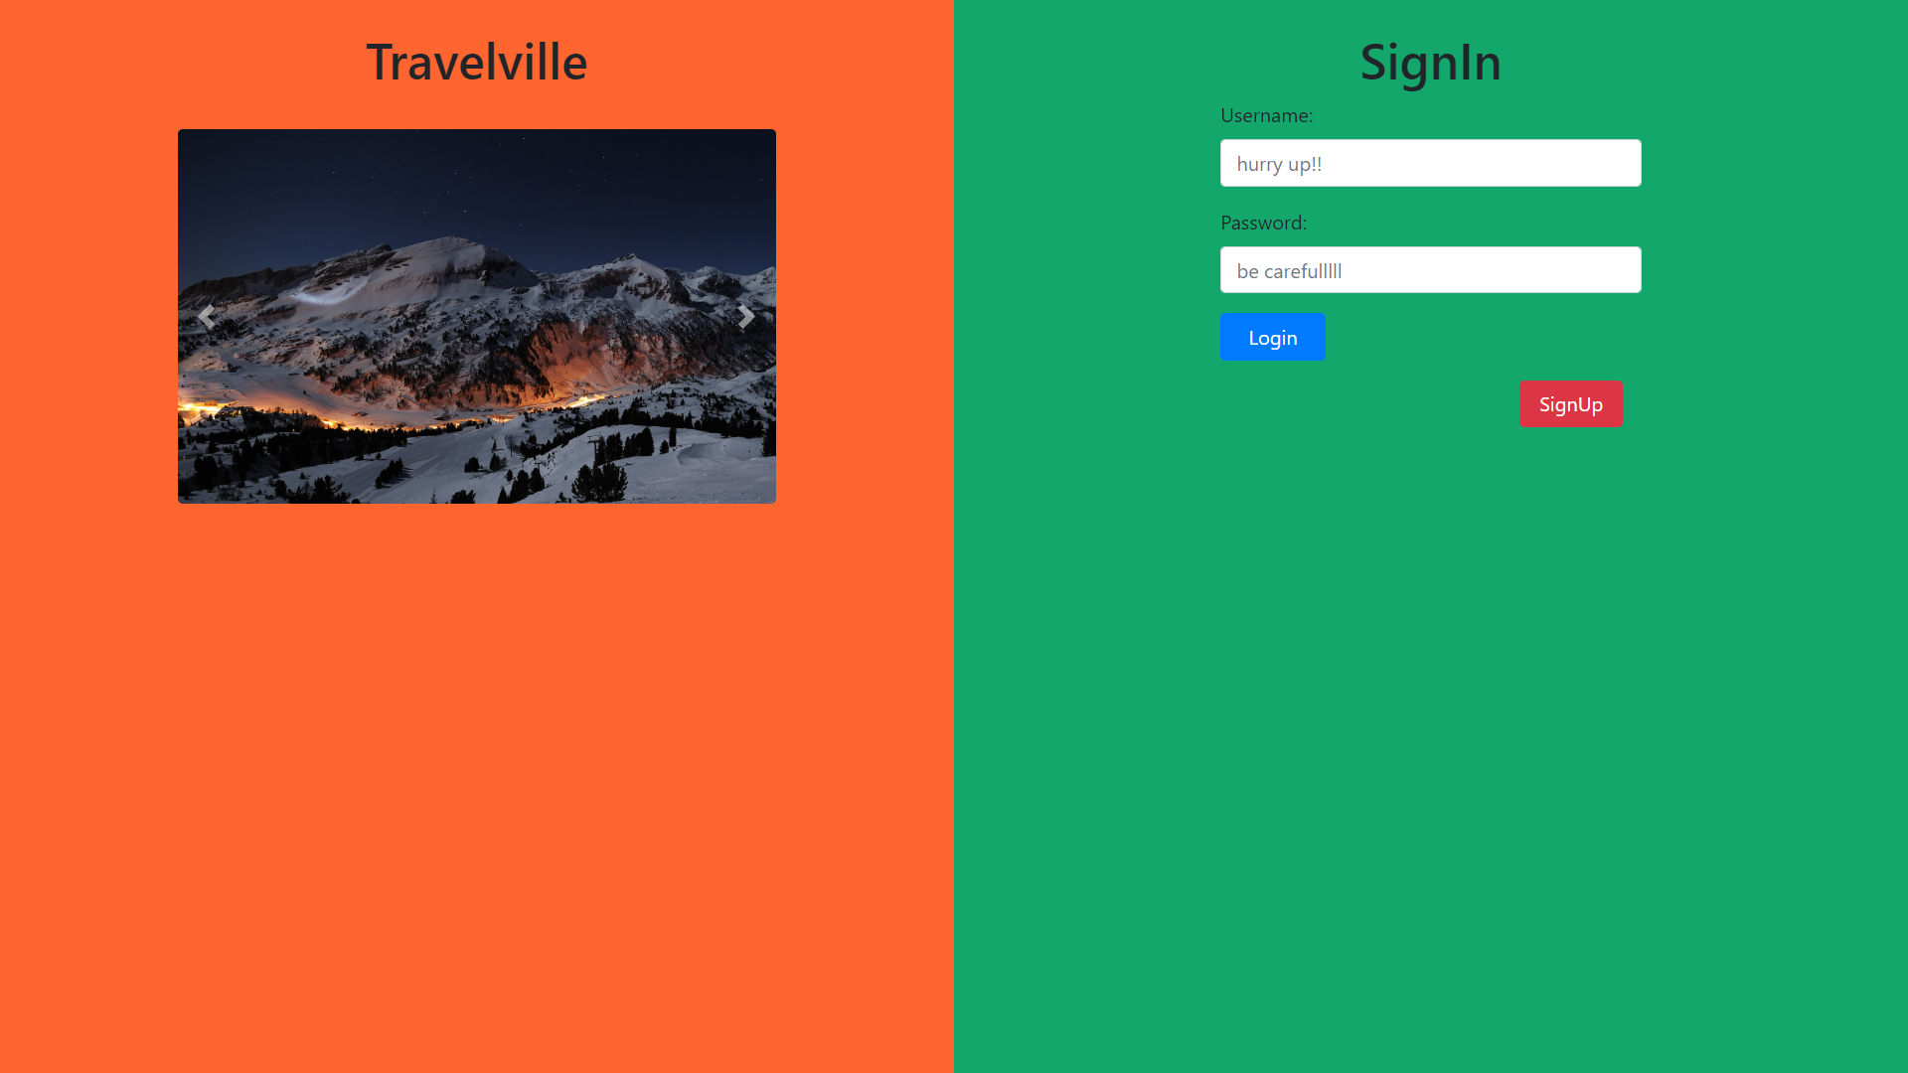
Login Page Designed With Bootstrap showing a carousel of beautiful tourist spots and also providing an option for signup page which can be found on the next slide.

Slide 5
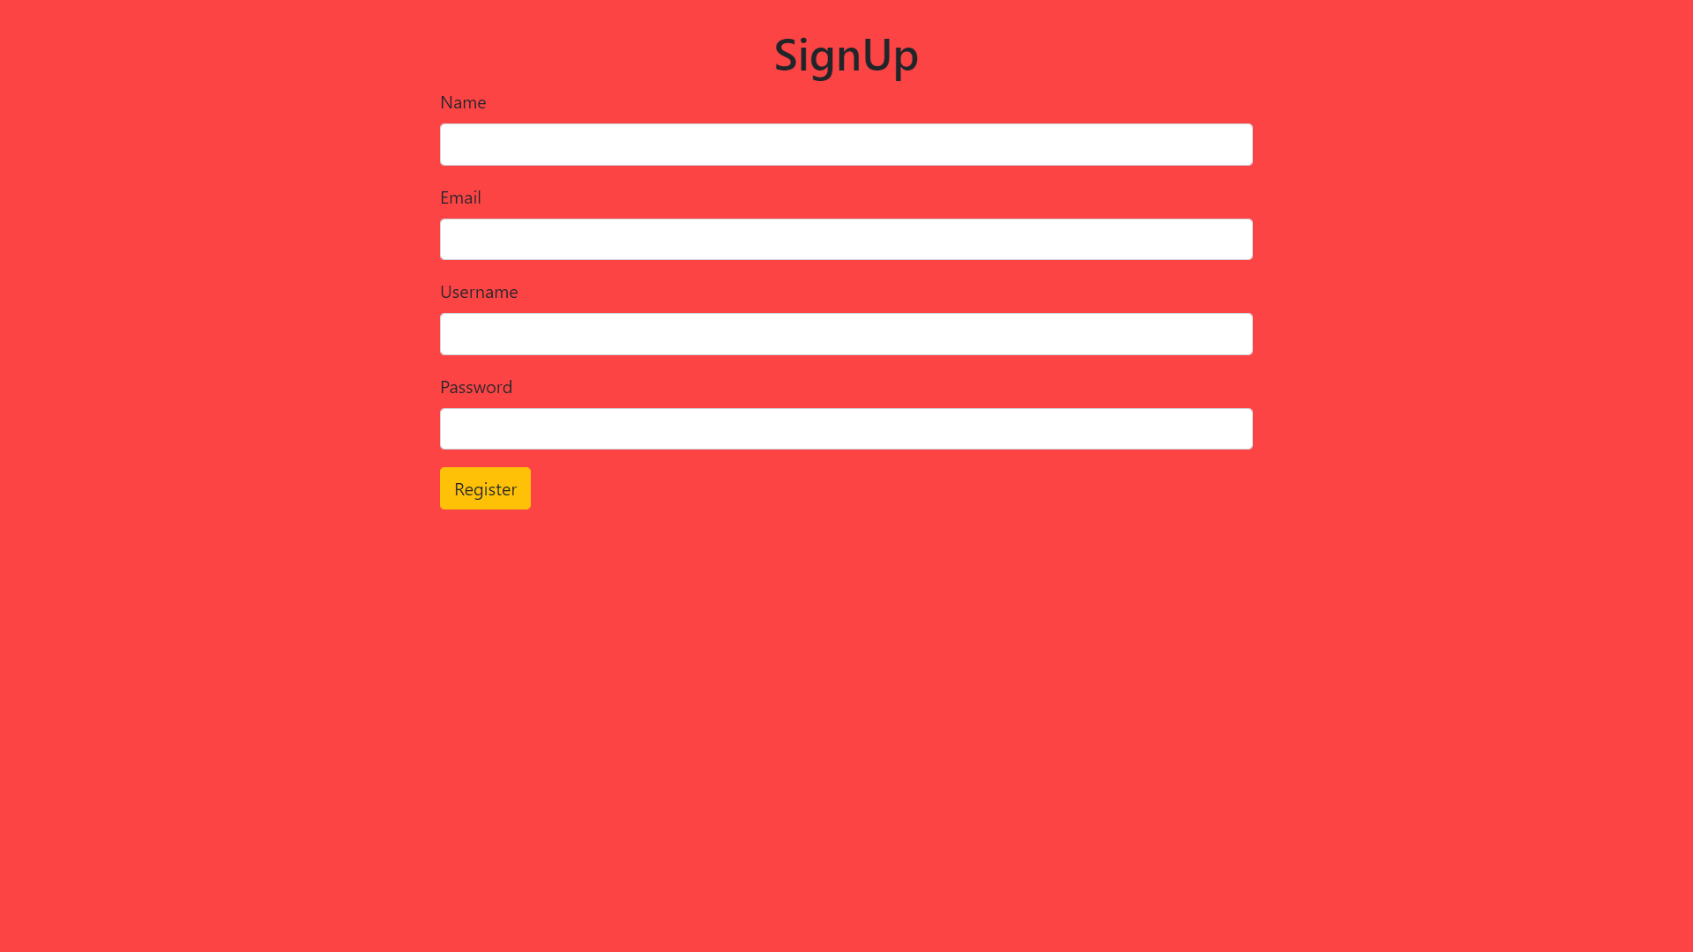
Registration Page with client side form verification and registration details are being stored directly in the non-sql MongoDB database.

Slide 6
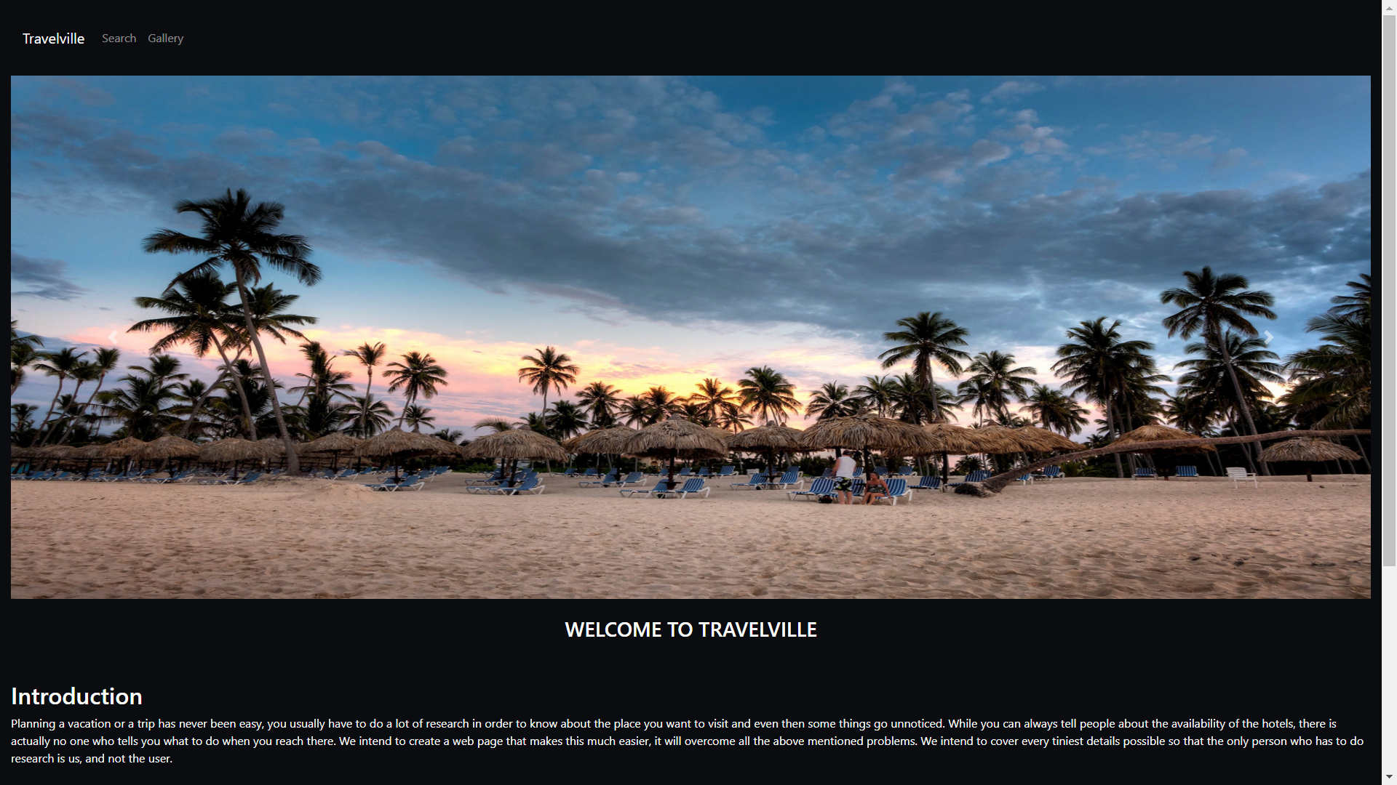
Main Travel Page After Successful User Login.

Slide 7
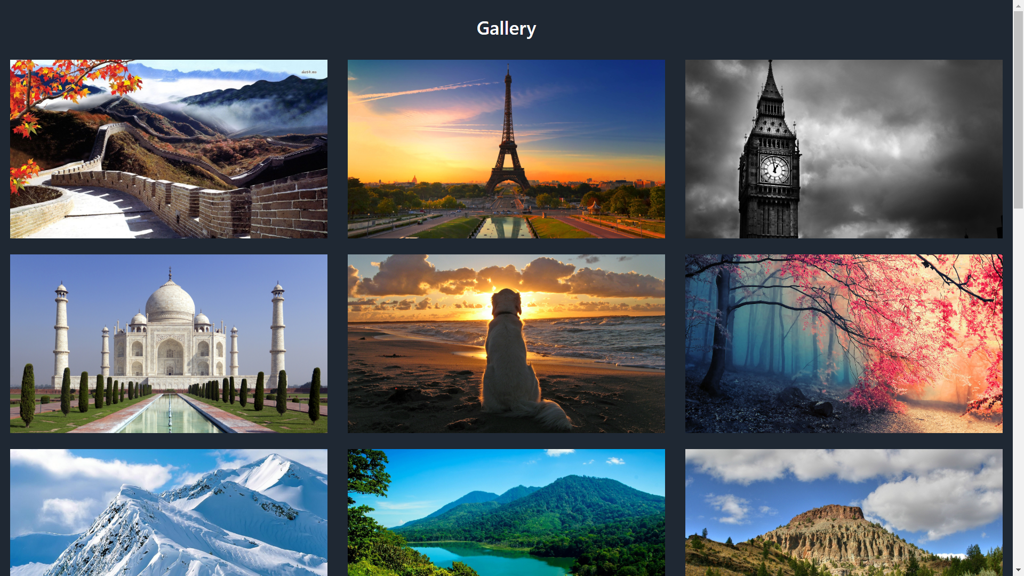
You can browse some famous tourist spots here .

Slide 8
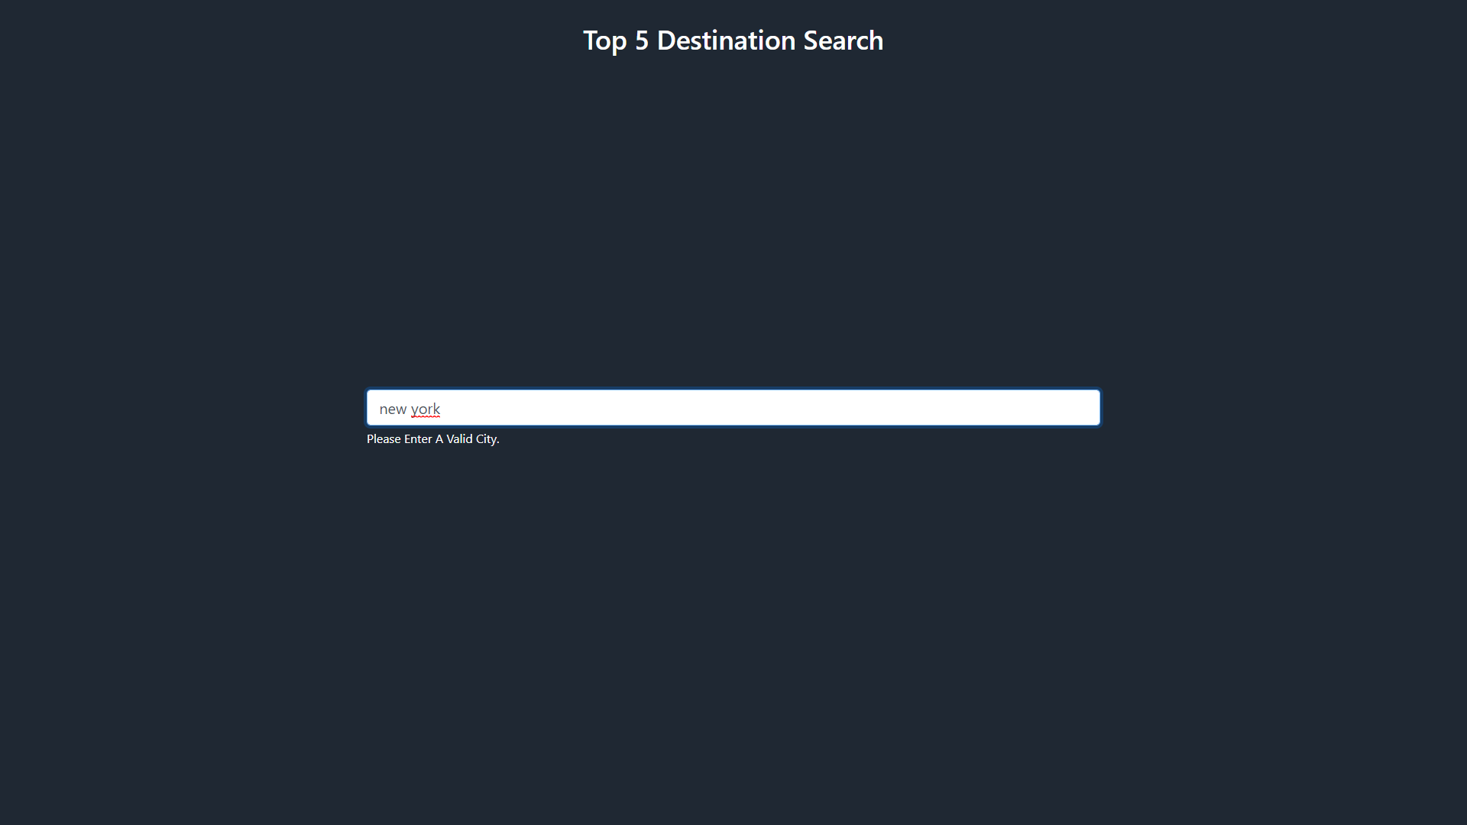
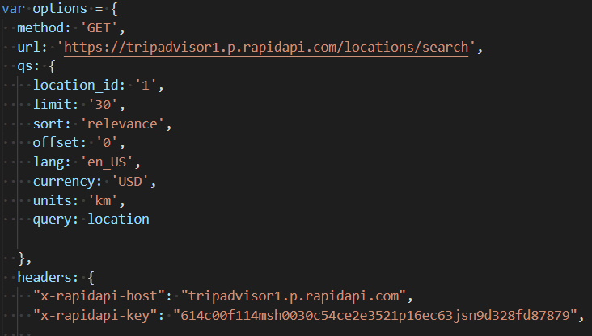
Top 5 location searcher with the help of trip-advisor API it will display the most recommended places to visit in any city in the world.
API call to get the location id based on location entered above and then find the top 5 attractions using that location id.
Visit Next Slide To Check Top 5 Places In New York.

Slide 9
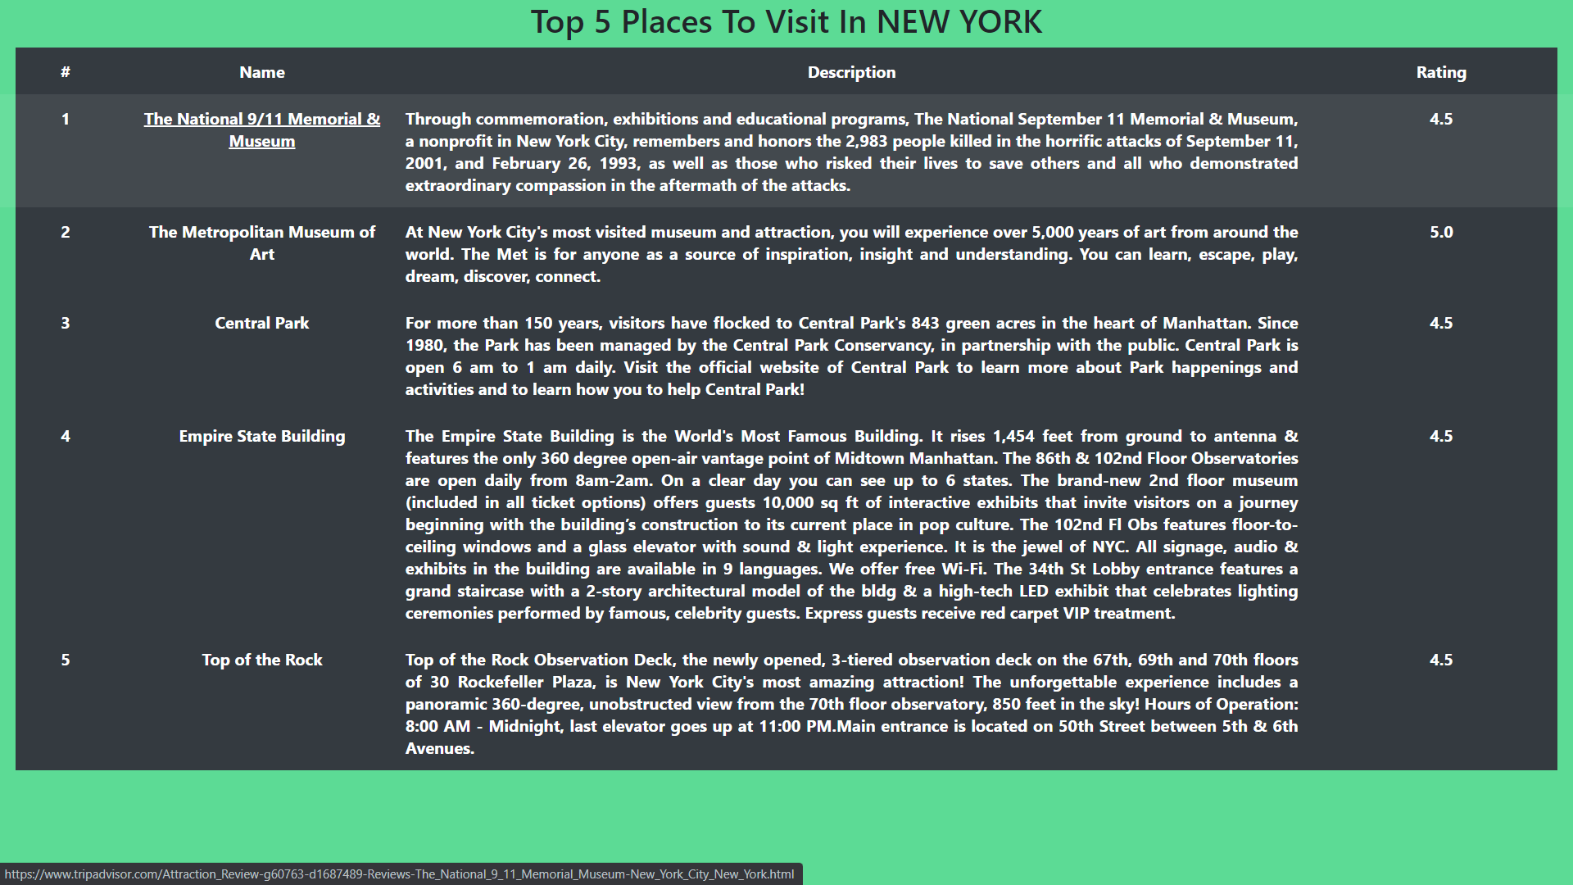
Top 5 Results Page Made Using Pug Template Engine.

Slide 10
THANK YOU
THANKS FOR STICKING WITH US TILL THE END .
THIS IS OUR FIRST ATTEMPT TO MAKE A TRAVEL WEBSITE USING APIs
WE WILL ADD MORE FEATURES IN THE FUTURE.

